Slide 1
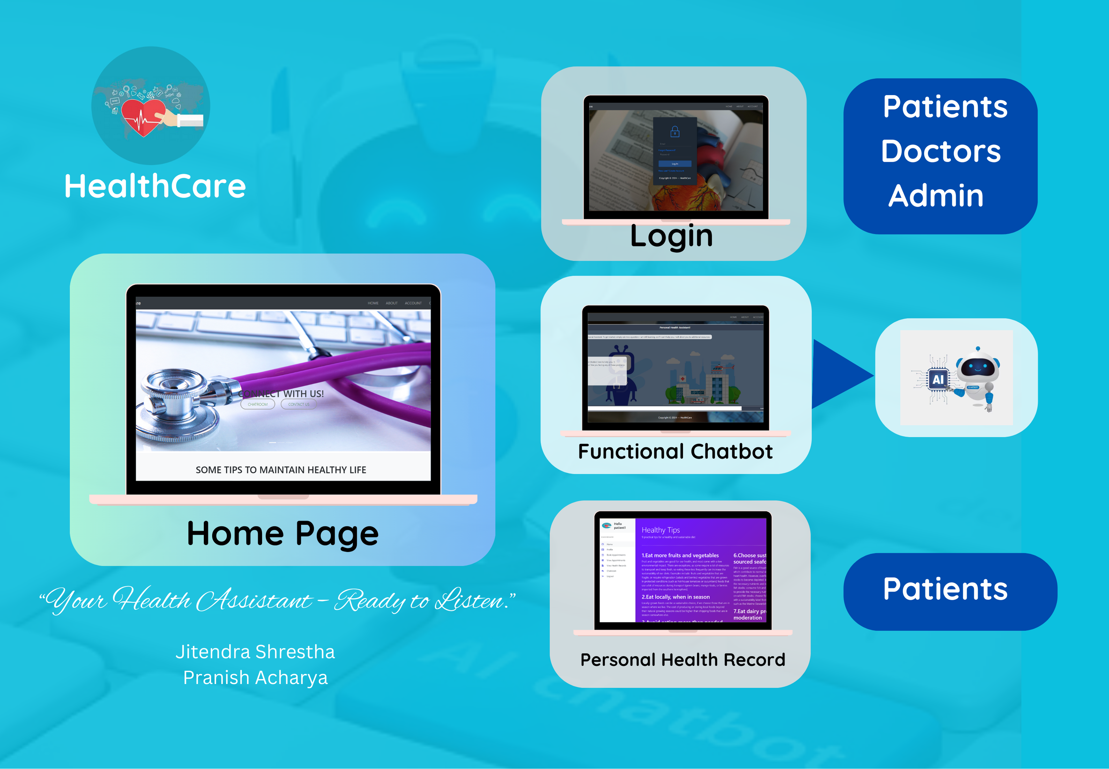

Slide 2
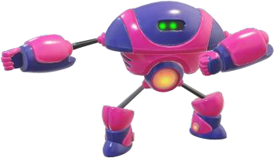
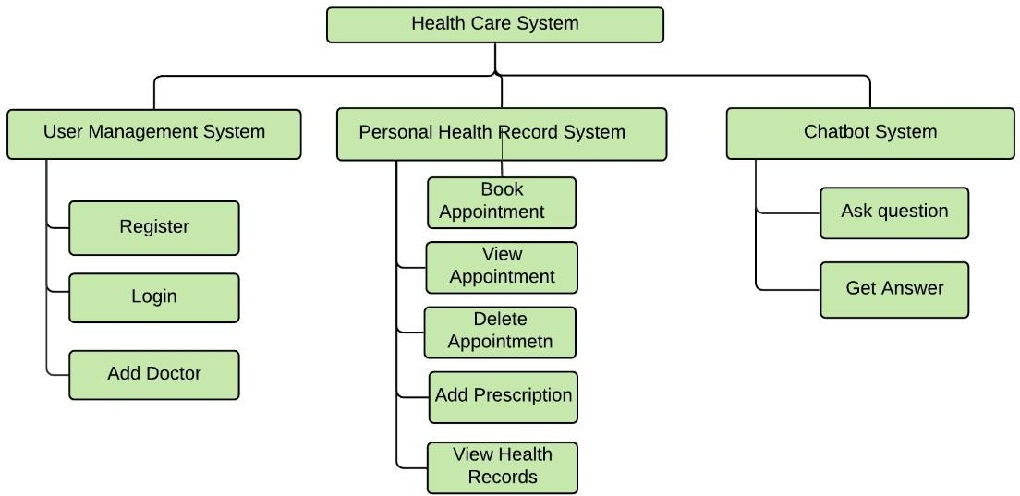
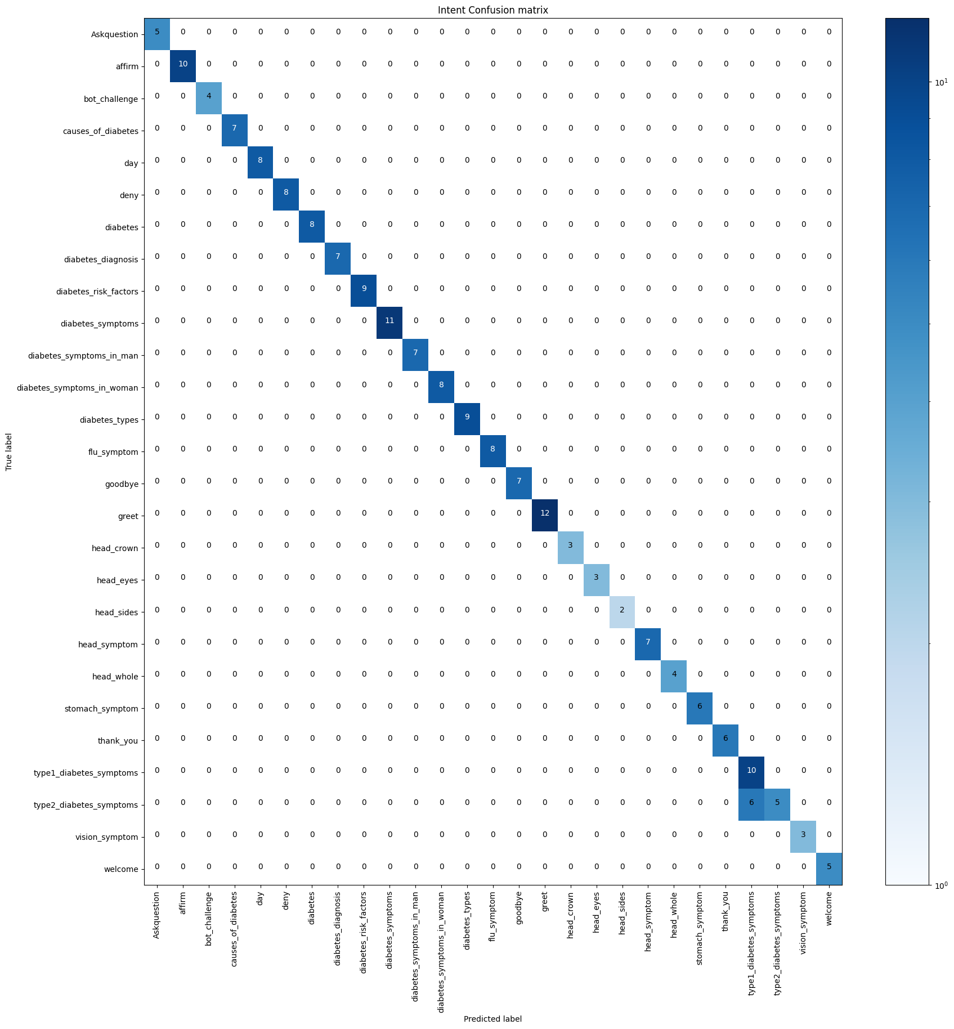
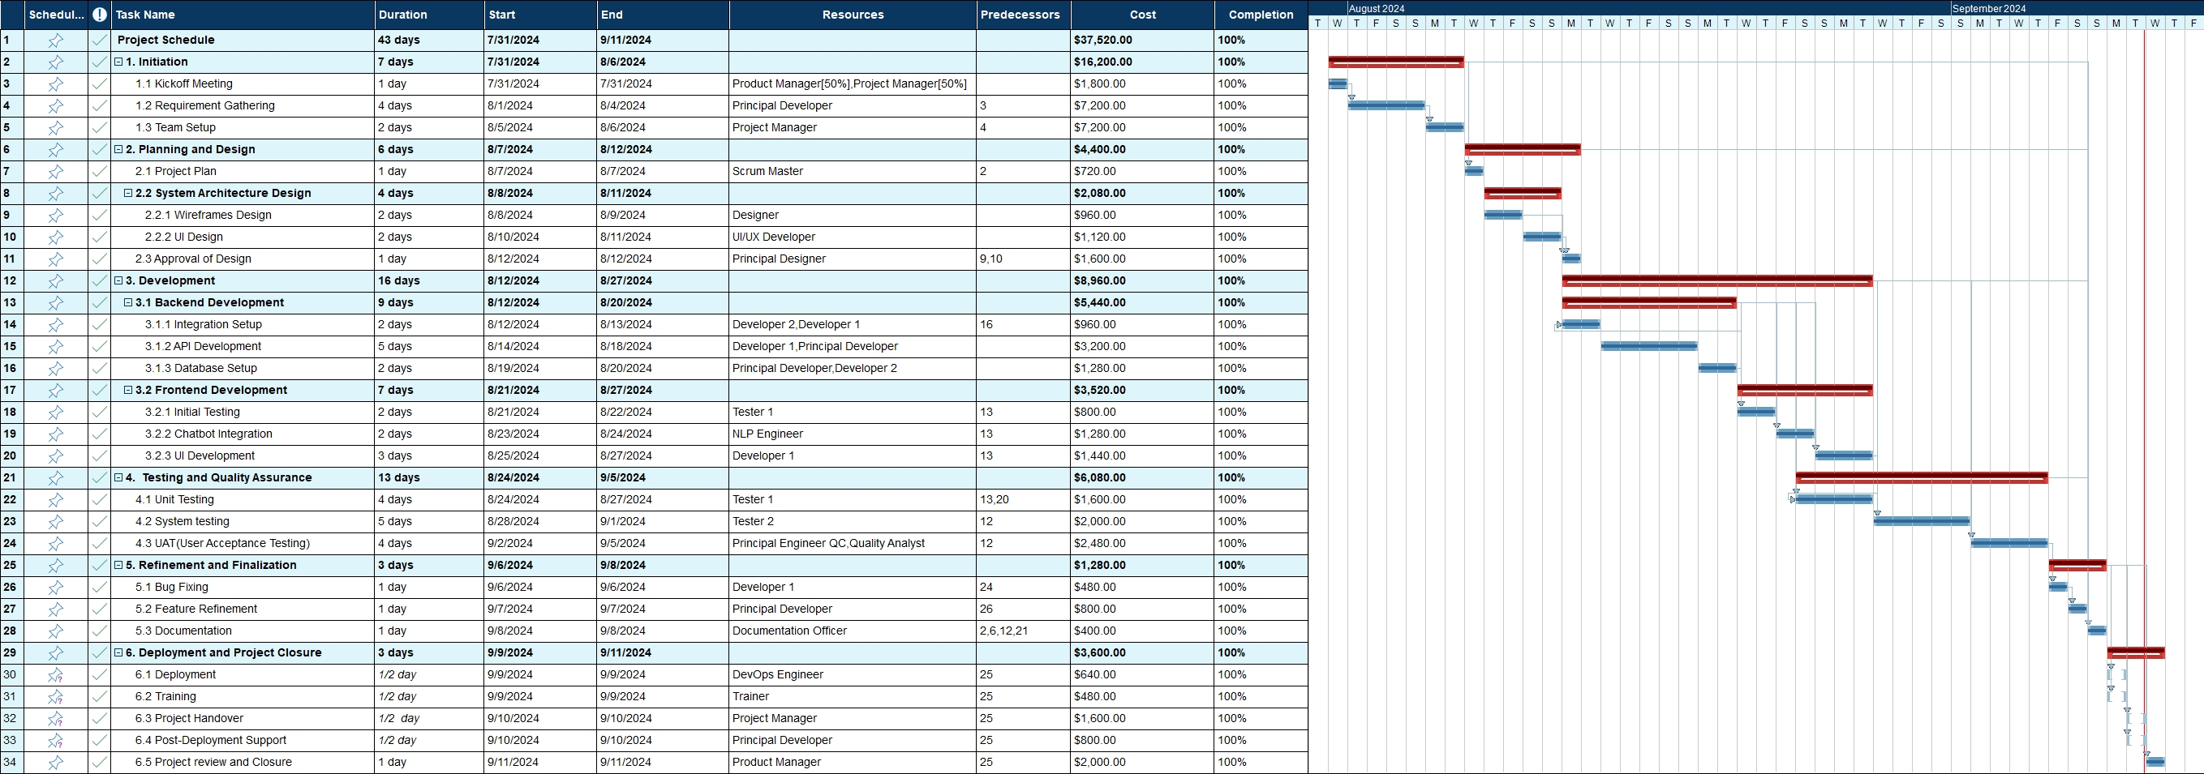
Jitendra Shrestha
Pranish Acharya
HealthCare Chatbot System
Supervisor : Fakhra Jabeen
Artifact
INTRODUCTION
Literature Review
Service that provides to the user/client through interpreting natural language
Serves as healthcare assistant
Provides quick responses to common medical symptoms
Seamless User Experience
SN | Authors | Algorithm | Accuracy
1 | Deshpande, Mrs. Rashmi Dharwadkar & Dr.Mrs. Neeta A. | Support Vector Machine Algorithm (SVM). | 92%
2 | Vipasha Chandwani, Sandeep Kumar & Parikshit Kishor Singh | LSTM model | 83%
3 | Ming-Hsiang Su, Chung-Hsien Wu, Kun-Yi Huang, Qian- Bei Hong, Hsin-Min Wang | LSTM-based Multi- Layer Embedding | 79%
4 | Md. Moshiur Rahman, Ruhul Amin, Md Nazmul Khan Liton and Nahid Hossain | Different algorithms (SVM, KNN, LSTM) | 98%
Aims and Objectives
To provide response on health queries
To diagnose disease based on symptoms provided based on yes/no statement
To provide way to maintain patient health record
Confusion Mattrix
Features
Can predict disease based on symptoms provided
User can book appointment
User can view health records
Doctors can provide prescription to booked appointment
Admin can manage doctors
Tracking Gantt Chart
Future Escalation
Conclusion
Used to predict all types of disease.
Used to recommend medicine.
Used to track heartrate, steps using sensor.
Psychological doctor bot
Popularity of the chatbot is increasing day by day
Different algorithm can be used .
AI has changed the way of communicating.
Huge scope in case of health care.

